Slide 1
CS 106A, Lecture 15 Events and Memory

Slide 2




HW4:
Breakout
Memory
The River of Java
You are here
Events
Animation
Graphics
Programs

Slide 3
Plan for Today
Announcements
Review: Null, Events and Instance Variables
Extra Practice: Googley Eyes
A Boolean Aside
Memory
Revisiting Whack-A-Mole
Notes:
Units = pixels
Assignment 4
Extra practice: UFO

Slide 4
Plan for Today
Announcements
Review: Null, Events and Instance Variables
Extra Practice: Googley Eyes
A Boolean Aside
Memory
Revisiting Whack-A-Mole
Notes:
Units = pixels
Assignment 4
Extra practice: UFO

Slide 5
Plan for Today
Announcements
Review: Null, Events and Instance Variables
Extra Practice: Googley Eyes
A Boolean Aside
Memory
Revisiting Whack-A-Mole

Slide 6
Null
Null is a special variable value that objects can have that means “nothing”. Primitives cannot be null.
If a method returns an object, it can return null to signify “nothing”. (just say return null;)
// may be a GObject, or null if nothing at (x, y)
GObject maybeAnObject = getElementAt(x, y);
Objects have the value null before being initialized.
Scanner myScanner; // initially null

Slide 7
Null
You can check if something is null using == and !=.
// may be a GObject, or null if nothing at (x, y)
GObject maybeAnObject = getElementAt(x, y);
if (maybeAnObject != null) {
// do something with maybeAnObject
} else {
// null – nothing at that location
}
Notes:
This is how we can finish dribbleCastle!

Slide 8
Null
Calling methods on an object that is null will crash your program!
// may be a GObject, or null if nothing at (x, y)
GObject maybeAnObject = getElementAt(x, y);
if (maybeAnObject != null) {
int x = maybeAnObject.getX(); // OK
} else {
int x = maybeAnObject.getX(); // CRASH!
}
Notes:
Think about null like an “invalid mailing address” – if you try to send messages to it, your messages bounce because the address is invalid

Slide 9
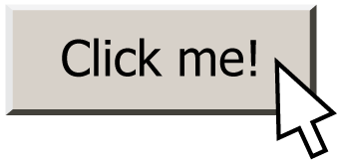
Events
event: Some external stimulus that your program can respond to.
event-driven programming: A coding style (common in graphical programs) where your code is executed in response to user events.

Slide 10
Events
public void run() {
// Java runs this when program launches
}
public void mouseClicked(MouseEvent event) {
// Java runs this when mouse is clicked
}
public void mouseMoved(MouseEvent event) {
// Java runs this when mouse is moved
}
Notes:
these new methods also have to be specifically named.
Just like run, these methods are called by Java, not by our code!

Slide 11
Types of Mouse Events
There are many different types of mouse events.
Each takes the form: public void eventMethodName(MouseEvent event) { ...
Method | Description
mouseMoved | mouse cursor moves
mouseDragged | mouse cursor moves while button is held down
mousePressed | mouse button is pressed down
mouseReleased | mouse button is lifted up
mouseClicked | mouse button is pressed and then released
mouseEntered | mouse cursor enters your program's window
mouseExited | mouse cursor leaves your program's window

Slide 12
MouseEvent Objects
A MouseEvent contains information about the event that just occurred:
Method | Description
e.getX() | the x-coordinate of mouse cursor in the window
e.getY() | the y-coordinate of mouse cursor in the window

Slide 13
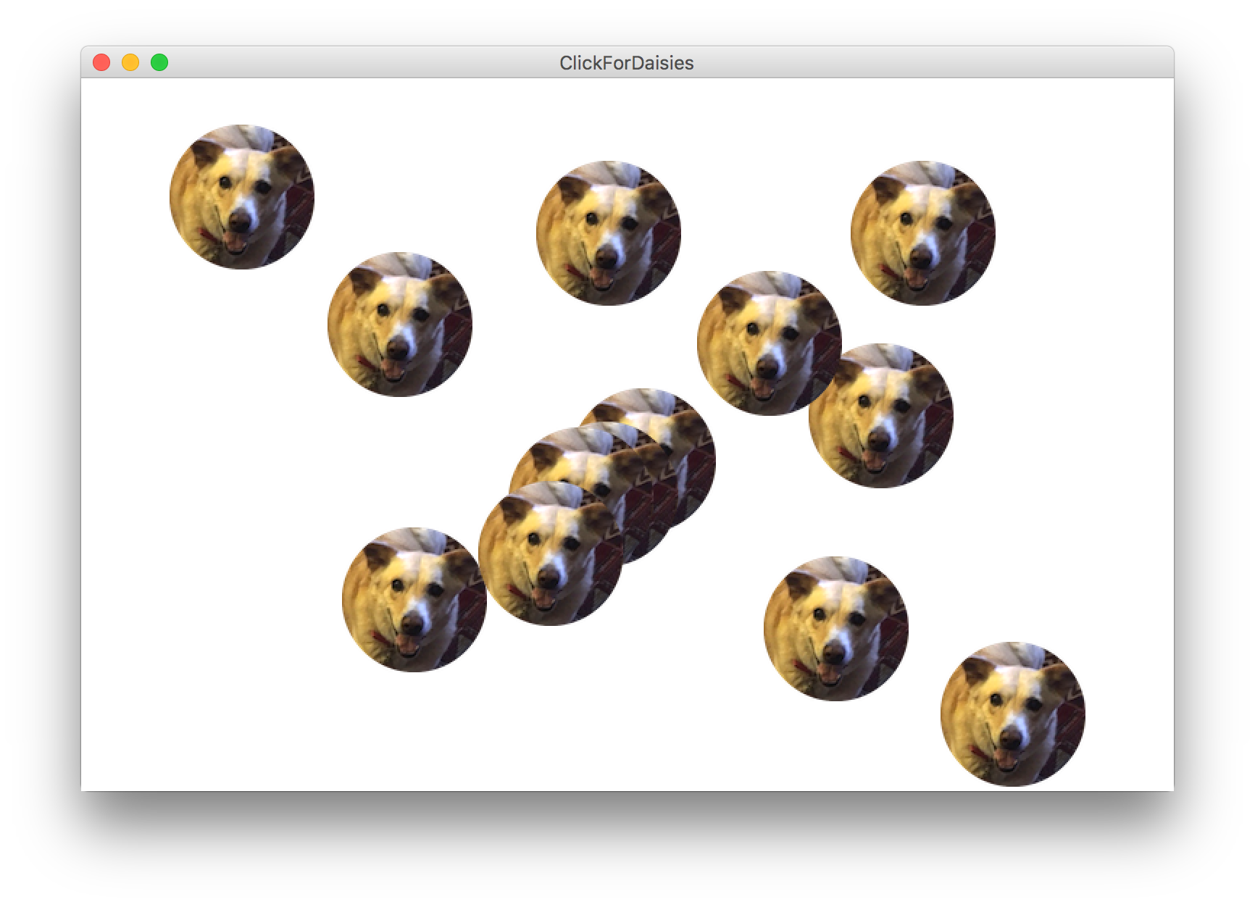
Example: ClickForDaisies

Slide 14
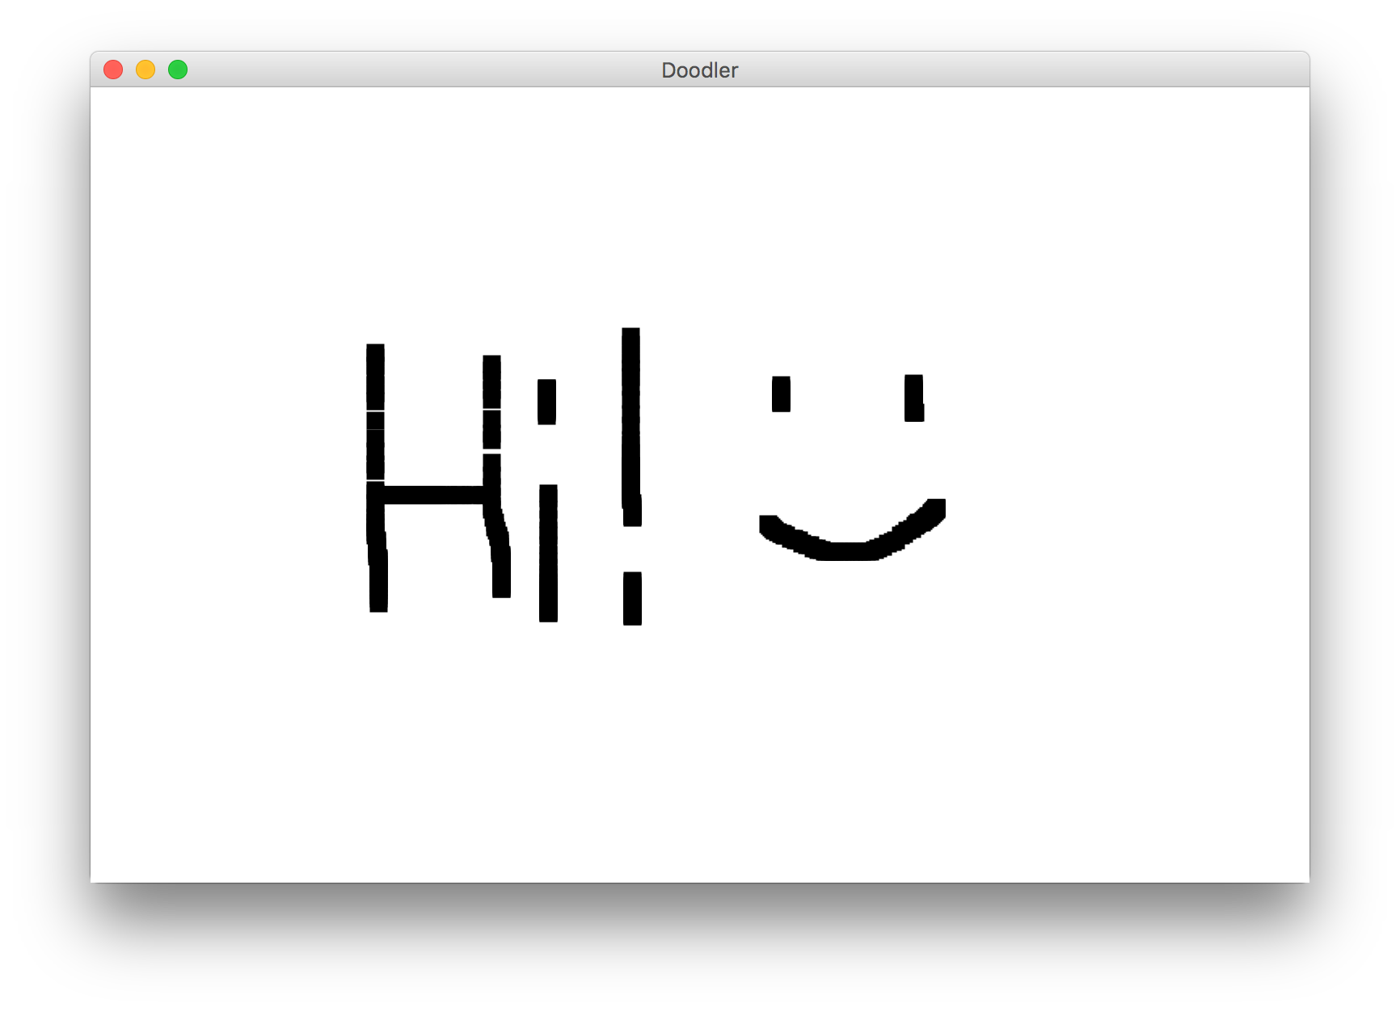
Example: Doodler
Notes:
Uses mouseDragged

Slide 15
Doodler
public void mouseDragged(MouseEvent event) {
double mouseX = event.getX();
double mouseY = event.getY();
double rectX = mouseX – SIZE / 2.0;
double rectY = mouseY – SIZE / 2.0;
GRect rect = new GRect(rectX, rectY, SIZE, SIZE);
rect.setFilled(true);
add(rect);
}
What if we wanted the same GRect to track the mouse, instead of making a new one each time?
Notes:
No way to do this! We can’t pass parameters since we don’t call mouse event methods
No way for information to live between mouse dragged calls – no variables live then!
No way to access information about previous drag

Slide 16
Instance Variables
private type name; // declared outside of any method
Instance variable: A variable that lives outside of any method.
The scope of an instance variable is throughout an entire file (class).
Useful for data that must persist throughout the program, or that cannot be stored as local variables or parameters (event handlers).
It is bad style to overuse instance variables
Notes:
Because they have a large scope, it is considered bad style to use too many instance variables, or to make something an instance variable that could instead be a local variable, parameter, return, etc.

Slide 17
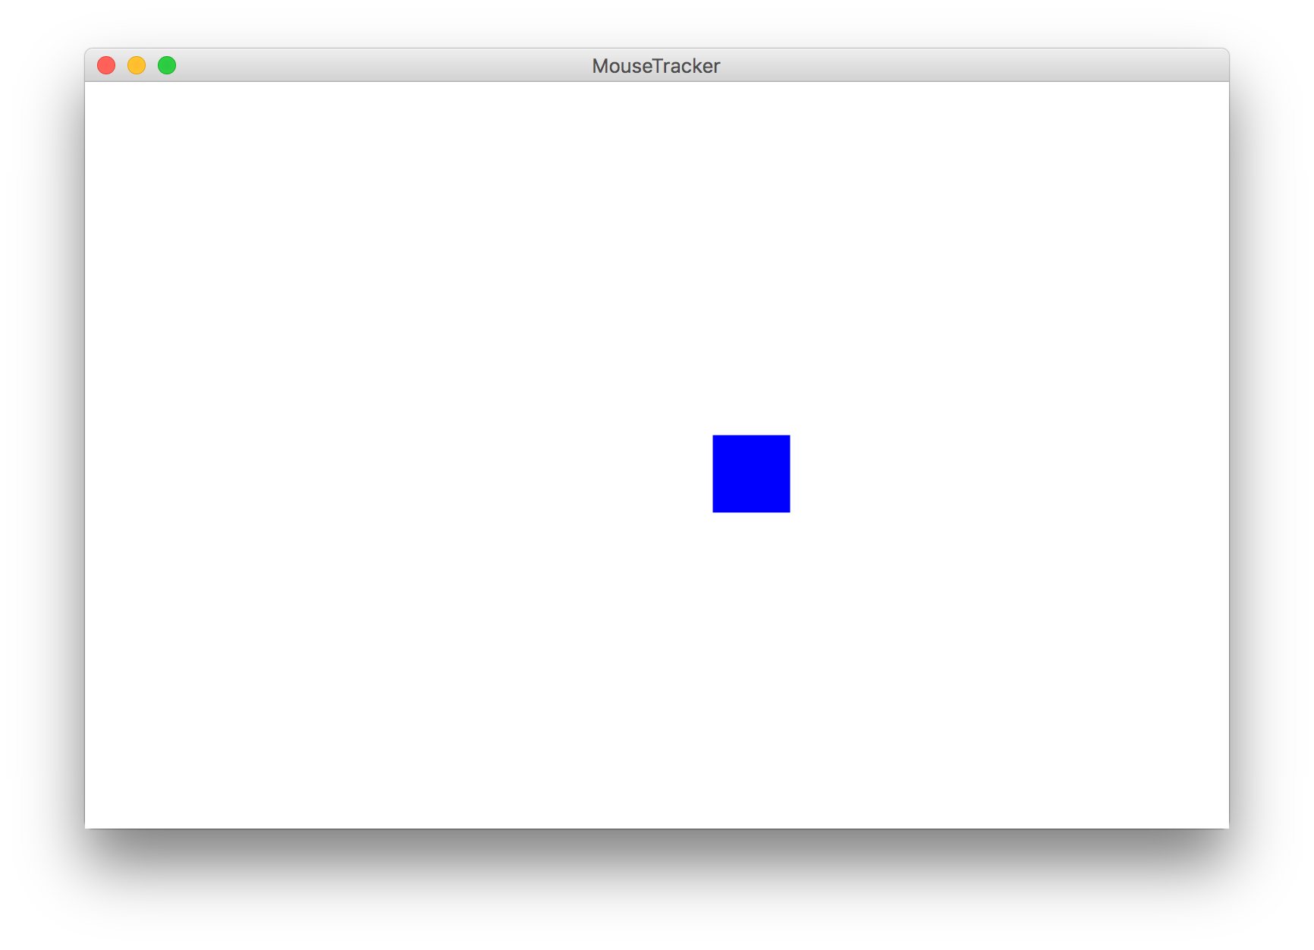
Example: MouseTracker

Slide 18
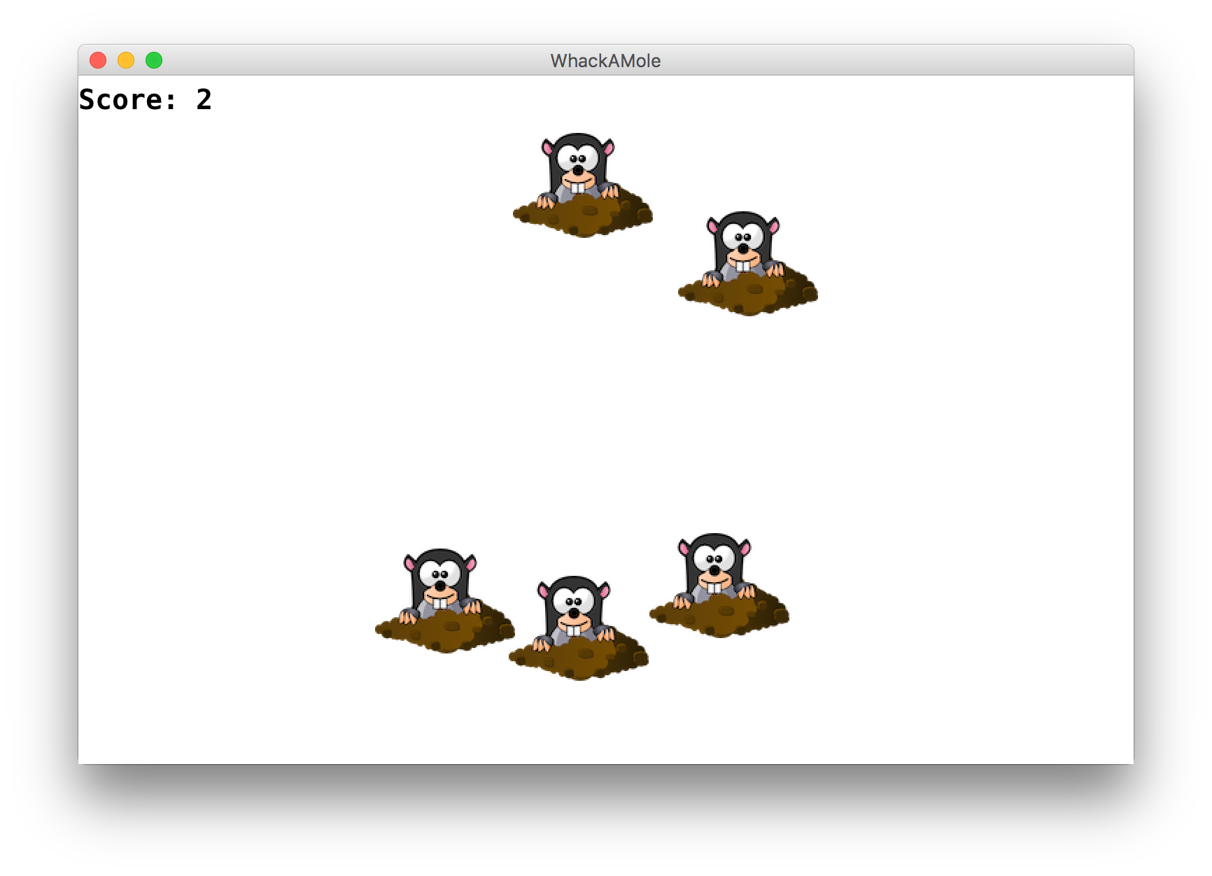
Whack-A-Mole
We used instance variables and events to make Whack-A-Mole!
A mole should appear every second at a random location, and stop once the user has gotten at least 10 points.
If the user clicks a mole, remove it and increase their score by 1
There should be a GLabel in the left corner showing their score
Notes:
Run: init graphics and adding moles
MouseClicked – remove moles, increment score
Ivars: label and score

Slide 19
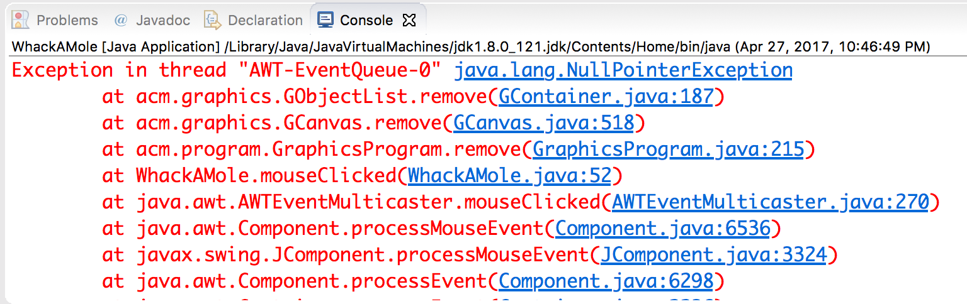
Exception
If the user clicks an area with no mole, the program crashes.
A program crash in Java is called an exception.
When you get an exception, Eclipse shows red error text.
The error text shows the line number where the error occurred.
Why did this error happen?
How can we avoid this?

Slide 20
Whack-A-Null?
public void mouseClicked(MouseEvent event) {
double mouseX = event.getX();
double mouseY = event.getY(); GObject mole = getElementAt(mouseX, mouseY);
remove(mole);
score++;
scoreLabel.setText("Score: " + score);
}
Notes:
1) Returns GObject
What’s the problem here?

Slide 21
Whack-A-Null?
public void mouseClicked(MouseEvent event) {
double mouseX = event.getX();
double mouseY = event.getY(); GObject mole = getElementAt(mouseX, mouseY);
remove(mole);
score++;
scoreLabel.setText("Score: " + score);
}
Problem: mole may be null if the user doesn’t click on a mole! Removing null will crash ☹

Slide 22
Whack-A-Mole!
public void mouseClicked(MouseEvent event) {
double mouseX = event.getX();
double mouseY = event.getY(); GObject mole = getElementAt(mouseX, mouseY);
if (mole != null) {
remove(mole);
score++;
scoreLabel.setText("Score: " + score);
}
}

Slide 23
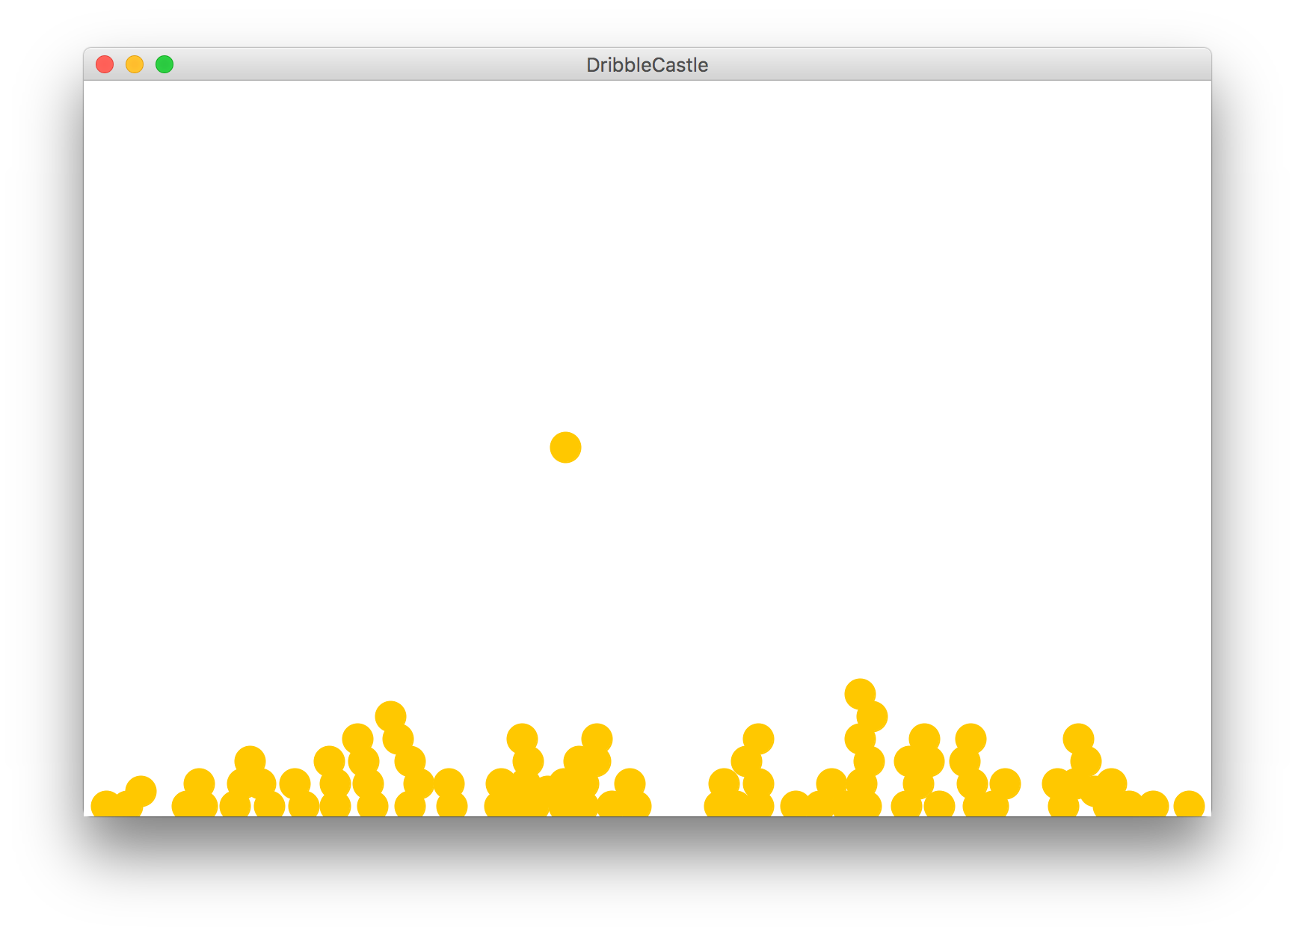
Revisiting DribbleCastle
We wrote a program called DribbleCastle that simulates wet sand falling and forming cool shapes.
But we left out one part: how do we stop the animation if one dribble collides with another?

Slide 24
DribbleCastle
private void dropOneDribble() {
GOval dribble = makeDribble();
add(dribble);
while (!hasHitBottom(dribble) && !hasHitSomethingElse(dribble)) {
dribble.move(0, Y_VELOCITY);
pause(PAUSE_TIME);
}
}

Slide 25
DribbleCastle
private void dropOneDribble() {
GOval dribble = makeDribble();
add(dribble);
while (!hasHitBottom(dribble) && !hasHitSomethingElse(dribble)) {
dribble.move(0, Y_VELOCITY);
pause(PAUSE_TIME);
}
}

Slide 26
DribbleCastle
private void dropOneDribble() {
GOval dribble = makeDribble();
add(dribble);
while (!hasHitBottom(dribble) && !hasHitSomethingElse(dribble)) {
dribble.move(0, Y_VELOCITY);
pause(PAUSE_TIME);
}
}

Slide 27
hasHitSomethingElse
private boolean hasHitSomethingElse(GOval dribble) {
double checkX = dribble.getX()
+ dribble.getWidth() / 2.0;
double checkY = dribble.getY()
+ dribble.getHeight() + 1;
GObject hit = getElementAt(checkX, checkY);
return hit != null;
}

Slide 28
hasHitSomethingElse
private boolean hasHitSomethingElse(GOval dribble) {
double checkX = dribble.getX()
+ dribble.getWidth() / 2.0;
double checkY = dribble.getY()
+ dribble.getHeight() + 1;
GObject hit = getElementAt(checkX, checkY);
return hit != null;
}
Need to check outside of the GOval itself! Otherwise, getElementAt may return the dribble.
Check if something is here

Slide 29
Plan for Today
Announcements
Review: Null, Events and Instance Variables
Extra Practice: Googley Eyes
A Boolean Aside
Memory
Revisiting Whack-A-Mole

Slide 30
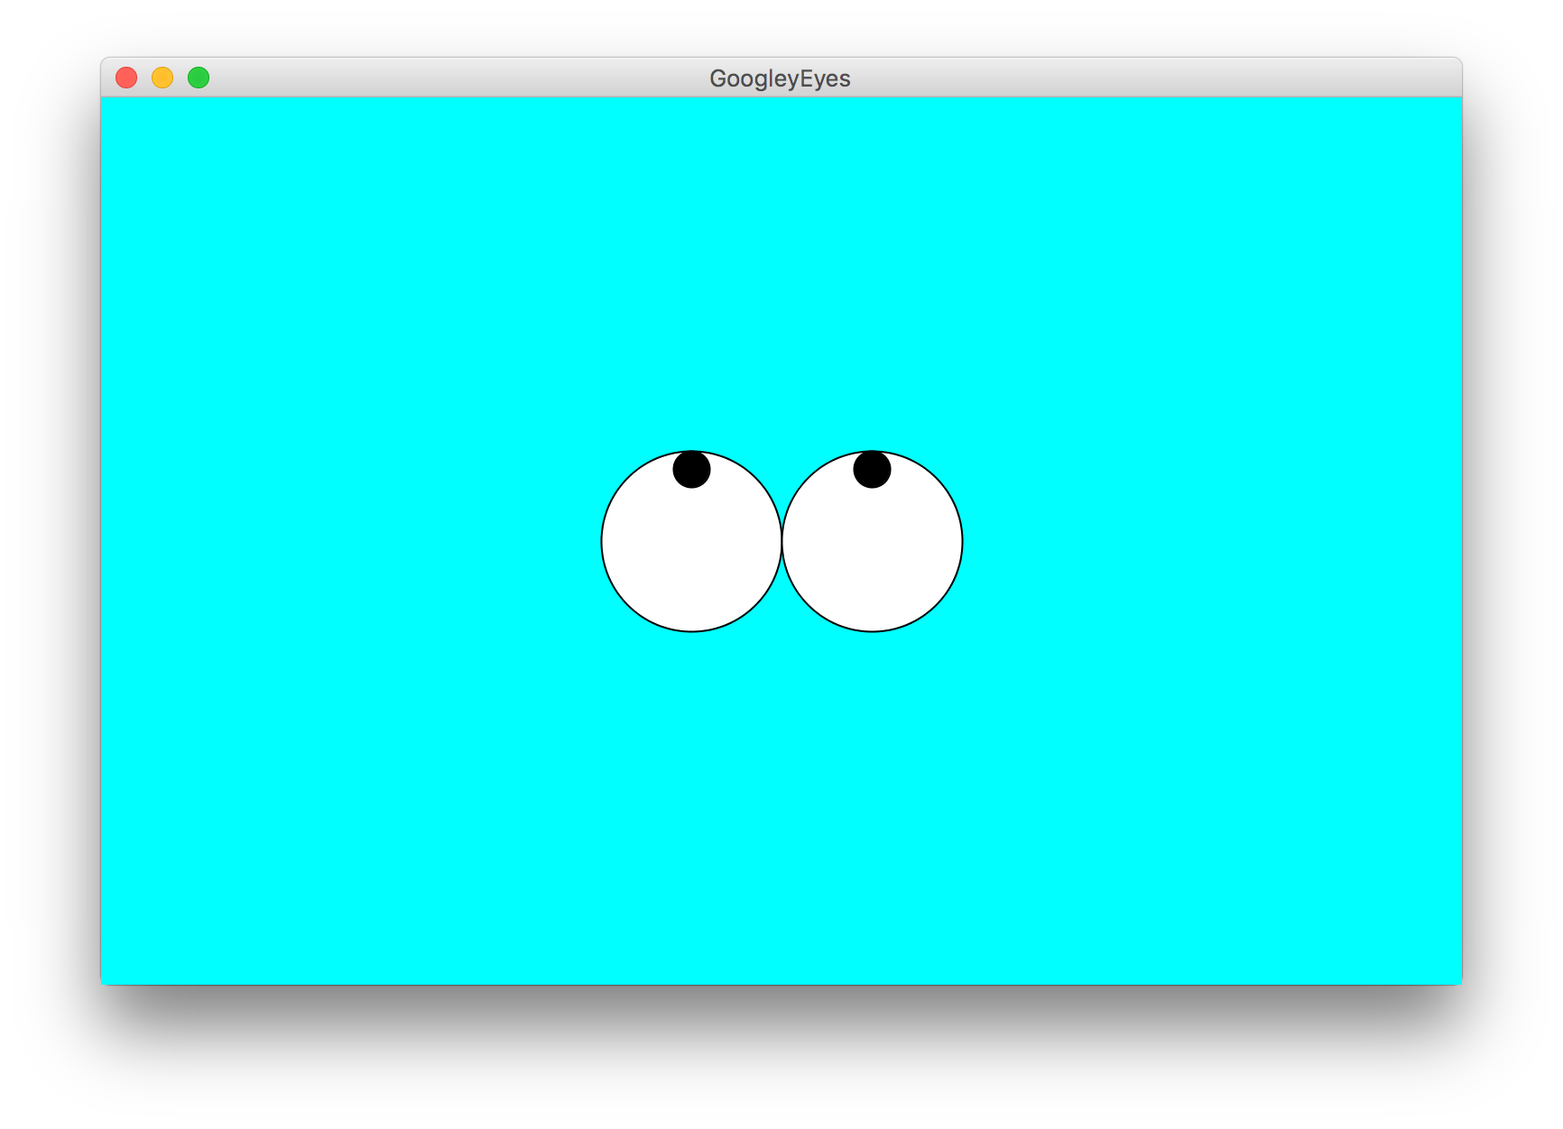
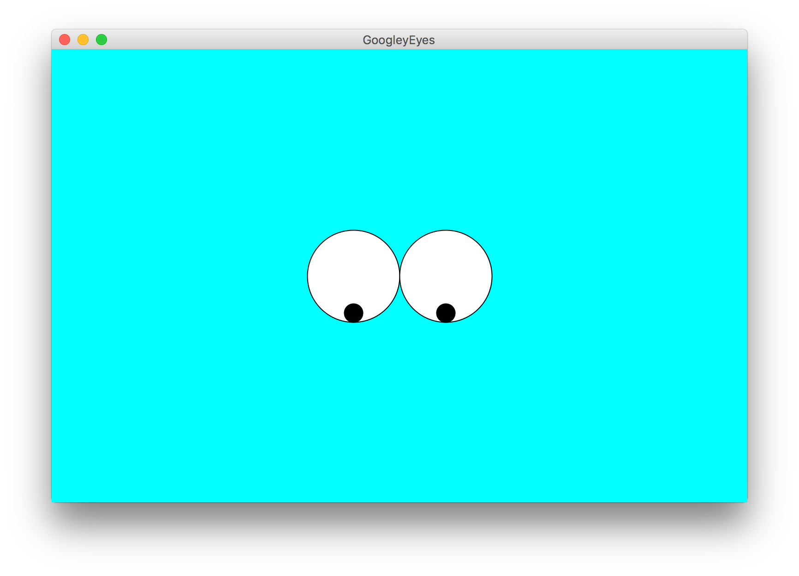

Extra Practice: GoogleyEyes
Let’s write a program called GoogleyEyes that draws eyes whose pupils follow the user’s mouse vertically as it moves around.

Slide 31
Plan for Today
Announcements
Review: Null, Events and Instance Variables
Extra Practice: Googley Eyes
A Boolean Aside
Memory
Revisiting Whack-A-Mole

Slide 32
A Boolean Aside
There is one helpful property of how Java evaluates boolean expressions, called short-circuit evaluation.
When evaluating boolean expressions, Java only evaluates as much of the expression as it needs to in order to evaluate it to be true or false.

Slide 33
A Boolean Aside
String str = readLine("? ");
if (str.length() > 0 && str.charAt(0) == 'A') {
...
}

Slide 34
A Boolean Aside
String str = readLine("? "); // what about “”!
if (str.length() > 0 && str.charAt(0) == 'A') {
...
}

Slide 35
A Boolean Aside
String str = readLine("? "); // what about “”!
if (str.length() > 0 && str.charAt(0) == 'A') {
...
}

Slide 36
A Boolean Aside
String str = readLine("? "); // what about “”!
if (str.length() > 0 && str.charAt(0) == 'A') {
...
}
Java only executes this if the first part is true! This means it never crashes.

Slide 37
A Boolean Aside
GObject obj = getElementAt(x, y);
if (obj == null || obj.getX() == 0) {
...
}

Slide 38
A Boolean Aside
GObject obj = getElementAt(x, y); // what about null!
if (obj == null || obj.getX() == 0) {
...
}

Slide 39
A Boolean Aside
GObject obj = getElementAt(x, y); // what about null!
if (obj == null || obj.getX() == 0) {
...
}

Slide 40
A Boolean Aside
GObject obj = getElementAt(x, y); // what about null!
if (obj == null || obj.getX() == 0) {
...
}
Java only executes this if the first part is false! This means it never crashes.

Slide 41
Plan for Today
Announcements
Review: Null, Events and Instance Variables
Extra Practice: Googley Eyes
A Boolean Aside
Memory
Revisiting Whack-A-Mole

Slide 42

By Chris Piech

Slide 43
origin
Nick Troccoli
By Chris Piech

Slide 44
Chapter 1: Birth

Slide 45
Once upon a time…

Slide 46
…a variable x was born!
int x;

Slide 47
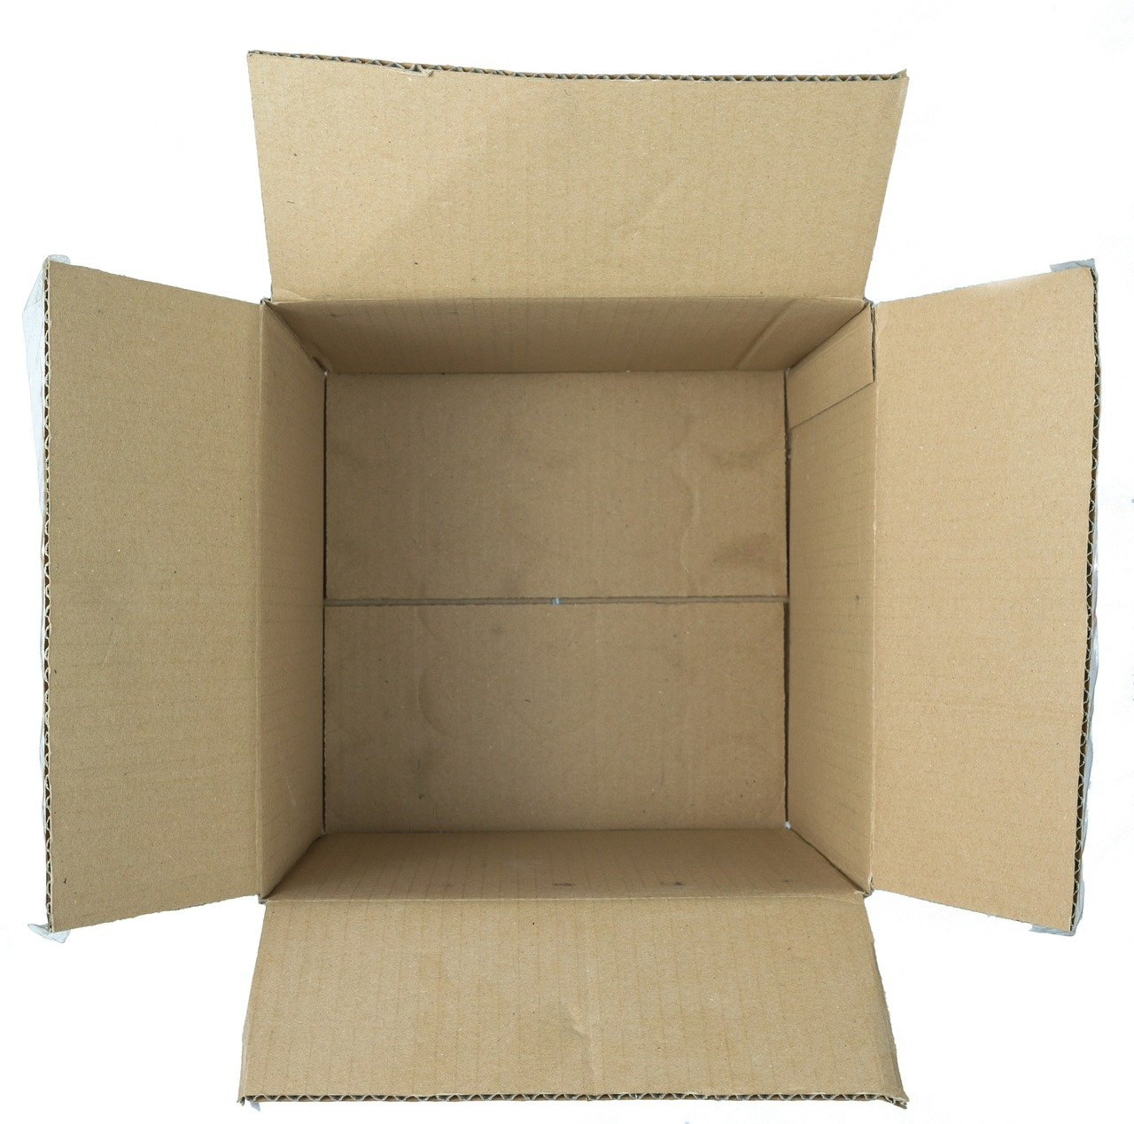
…a variable x was born!
int x;

Slide 48
x was a primitive variable…
int x;
It’s so cuuuute!
Aww…!

Slide 49
…and its parents loved it very much.
int x;
We should give it…. value 27!

Slide 50
…and its parents loved it very much.
x = 27;
We should give it…. value 27!
27

Slide 51
A few years later, the parents decided to have another variable.

Slide 52
…and a variable rect was born!
GRect rect;

Slide 53
rect was an object variable…
GRect rect;
Who’s a cute GRect???
It’s so square!

Slide 54
…and its parents loved it very much.
GRect rect;
We should make it…. a big, strong GRect!

Slide 55
…and its parents loved it very much.
GRect rect = new Grect(0, 0, 50, 50);
We should make it…. a big, strong GRect!

Slide 56
…but rect’s box was not big enough for an object!
GRect rect = new Grect(0, 0, 50, 50);
That box isn’t big enough to store everything about a GRect!

Slide 57

…so they stored the information in a bigger box somewhere else.
GRect rect = new Grect(0, 0, 50, 50);
x = 0, y = 0
width = 50
height = 50
...
Location 5
See location 5
Notes:
Stack and heap

Slide 58
Chapter 2: Friends

Slide 59
…x makes a new friend!
int y = 27;
x
y
27
27

Slide 60
…x makes a new friend!
int y = 27;
Hi! I’m y.
x
y
27
27

Slide 61
…x makes a new friend!
int y = 27;
We have the same value!
x
y
27
27

Slide 62
…x makes a new friend!
int y = 27;
*blush*
x
y
27
27

Slide 63
They can use == to compare values.
if (x == y) { // true!
...
}
x
y
27
27

Slide 64
They can use == to compare values.
if (x == y) { // true!
...
}
❤️
x
y
27
27

Slide 65
See “A Variable Love Story” for more...

Slide 66
rect also makes a new friend!
GRect r = new Grect(0, 0, 50, 50);
rect
r
See location 5
See location 24
Notes:
Same values! Different location

Slide 67
Rect also makes a new friend!
GRect r = new Grect(0, 0, 50, 50);
Hi! I’m r.
rect
r
See location 5
See location 24

Slide 68
Rect also makes a new friend!
GRect r = new Grect(0, 0, 50, 50);
rect
r
It looks like we have the same size, location, everything!
See location 5
See location 24

Slide 69
Rect also makes a new friend!
GRect r = new Grect(0, 0, 50, 50);
*blush*
rect
r
See location 5
See location 24

Slide 70
But when they use == to compare values...

Slide 71
…something goes wrong.
if (rect == r) { // false!
...
}
rect
r
See location 5
See location 24

Slide 72
…something goes wrong.
if (rect == r) { // false!
...
}
…but…but I thought we had so much in common!
rect
r
See location 5
See location 24

Slide 73
…something goes wrong.
if (rect == r) { // false!
...
}
💔
rect
r
See location 5
See location 24

Slide 74
…something goes wrong.
if (rect == r) { // false!
...
}
You see, == compares what is in each variable’s box.
rect
r
See location 5
See location 24

Slide 75
…something goes wrong.
if (rect == r) { // false!
...
}
Primitives store their actual value in their box.
rect
r
See location 5
See location 24

Slide 76
…something goes wrong.
if (rect == r) { // false!
...
}
But objects store the location where all their information lives.
rect
r
See location 5
See location 24

Slide 77
…something goes wrong.
if (rect == r) { // false!
...
}
This means == on objects compares their locations, which is not what we want here!
rect
r
See location 5
See location 24

Slide 78
Chapter 3: Twins

Slide 79
One day, they wanted a twin.
Wow, what an awesome int! Let’s make another one.
x
27

Slide 80
One day, they wanted a twin.
Wow, what an awesome int! Let’s make another one.
int x2 = x;
x
27

Slide 81
…so x2 was born!
Wow, what an awesome int! Let’s make another one.
int x2 = x;
x
x2
27
27

Slide 82
…so x2 was born!
But let’s increment this one by 2.
int x2 = x;
x2 += 2;
x
x2
27
29

Slide 83
…so x2 was born!
int x2 = x;
x2 += 2;
Cool, I’m 29 now!
x
x2
27
29

Slide 84
…so x2 was born!
int x2 = x;
x2 += 2;
And I’m still 27!
x
x2
27
29

Slide 85
Then, they wanted a twin for rect, too.
Wow, what an awesome GRect! Let’s make another one.
rect
See location 5

Slide 86
…so rect2 was born!
Wow, what an awesome GRect! Let’s make another one.
GRect rect2 = rect;
rect
See location 5

Slide 87
…so rect2 was born!
Wow, what an awesome GRect! Let’s make another one.
GRect rect2 = rect;
rect
rect2
See location 5
See location 5

Slide 88
…so rect2 was born!
But let’s make this one BLUE.
GRect rect2 = rect;
rect2.setColor(Color.BLUE);
rect
rect2
See location 5
See location 5

Slide 89
…so they went to location 5 and changed the color to blue.
x = 0, y = 0
width = 50
height = 50
Color = BLUE
...
Location 5

Slide 90
But something went wrong…
GRect rect2 = rect;
rect2.setColor(Color.BLUE);
Cool, I’m blue!
rect
rect2
See location 5
See location 5

Slide 91
But something went wrong…
GRect rect2 = rect;
rect2.setColor(Color.BLUE);
Hey, why am I blue TOO?
rect
rect2
See location 5
See location 5

Slide 92
But something went wrong…
You see, when you set one variable equal to another, the value in its box is copied over.
GRect rect2 = rect;
rect2.setColor(Color.BLUE);
rect
rect2
See location 5
See location 5

Slide 93
But something went wrong…
GRect rect2 = rect;
rect2.setColor(Color.BLUE);
For primitive variables, this just means we copy their value.
rect
rect2
See location 5
See location 5

Slide 94
But something went wrong…
GRect rect2 = rect;
rect2.setColor(Color.BLUE);
But for objects, we copy its location instead.
rect
rect2
See location 5
See location 5

Slide 95
But something went wrong…
Therefore, both rect and rect2 think their information is at location 5.
GRect rect2 = rect;
rect2.setColor(Color.BLUE);
rect
rect2
See location 5
See location 5

Slide 96
But something went wrong…
When you change information for an object, you go to its location first, and then update the information.
GRect rect2 = rect;
rect2.setColor(Color.BLUE);
rect
rect2
See location 5
See location 5

Slide 97
But something went wrong…
Since rect and rect2 reference the same location, when you change information for one of them, it changes for both!
GRect rect2 = rect;
rect2.setColor(Color.BLUE);
rect
rect2
See location 5
See location 5

Slide 98
Chapter 4: Leaving the Nest

Slide 99
X grew up, and went to college.
college(x);
Bye everyone! I’m going to college.
x
27

Slide 100
X grew up, and went to college.
college(x);
We’ll miss you, honey! Don’t forget to call! Don’t stay up too late! Watch out for rogue bicyclists!
Bye everyone! I’m going to college.
x
27

Slide 101
X grew up, and went to college.
private void college(int num) {
...
}
run
college
x
num
27
27

Slide 102
x had an amazing college experience…
private void college(int num) {
num = 45;
}
run
college
x
num
27
45

Slide 103
...but ultimately returned home the same.
private void college(int num) {
num = 45;
}
run
college
x
num
27
45

Slide 104
…but ultimately returned home the same.
college(x);
println(x);
I’m baaaaack! And I’m still 27.
x
27

Slide 105
…but ultimately returned home the same.
college(x);
println(x);
I’m baaaaack! And I’m still 27.
Ohhhh honey! You’ll always be our little 27.
x
27

Slide 106
rect grew up too, and also went to college.
college2(rect);
Bye everyone! I’m going to college.
rect
See location 5

Slide 107
rect grew up too, and also went to college.
college2(rect);
Not you too, rect! We are empty nesters now…
Bye everyone! I’m going to college.
rect
See location 5

Slide 108
rect grew up too, and also went to college.
private void college2(GRect box) {
...
}
run
college2
rect
box
See location 5
See location 5

Slide 109
rect also had an amazing college experience…
private void college2(GRect box) {
box.setColor(Color.YELLOW);
}
run
college2
rect
box
See location 5
See location 5

Slide 110
rect also had an amazing college experience…
x = 0, y = 0
width = 50
height = 50
Color = YELLOW
...
Location 5

Slide 111
…but it returned home different.
private void college2(GRect box) {
box.setColor(Color.YELLOW);
}
run
college2
I’m yellow!
rect
box
See location 5
See location 5

Slide 112
…but it returned home different.
private void college2(GRect box) {
box.setColor(Color.YELLOW);
}
Hey, what gives! I’m yellow now too!
run
college2
I’m yellow!
rect
box
See location 5
See location 5

Slide 113
…but it returned home different.
college(rect);
add(rect);
I’m baaaaack! But now I’m yellow…
rect
See location 5

Slide 114
…but it returned home different.
college(rect);
add(rect);
I’m baaaaack! But now I’m yellow…
Oh my gosh….what happened to you??!
rect
See location 5

Slide 115
…but it returned home different.
college(rect);
add(rect);
You see, when a variable is passed as a parameter, the value inside its box is copied and given to the method.
rect
See location 5

Slide 116
…but it returned home different.
college(rect);
add(rect);
For primitives, we make a copy of their actual value. Therefore, changes to a parameter do not affect the original.
rect
See location 5

Slide 117
…but it returned home different.
college(rect);
add(rect);
However, for objects we make a copy of their location. So changes to the parameter do affect the original!
rect
See location 5

Slide 118
The End

Slide 119
Primitives vs. Objects
Primitives store their actual value in their variable box. You can compare values with == and !=, and the original does not change when passed as a parameter and changed.
Objects store their location in their variable box. You can’t compare properties of an object via ==, and the original does change when passed as a parameter and changed.
Primitives are passed by value, Objects are passed by reference

Slide 120
Practice – Chapter 2: Friends

Slide 121
Practice
public void run() {
int x = 5;
int y = 5;
println(x == y);
}
Does this print out true or false?
Notes:
true

Slide 122
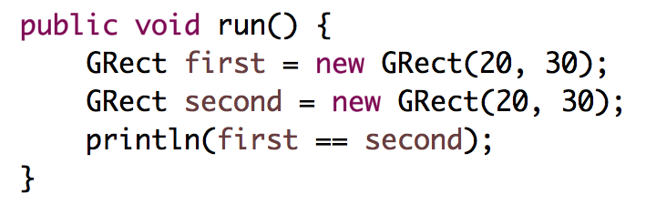
Practice
Does this print out true or false?
Notes:
Prints false!

Slide 123
Practice – Chapter 3: Twins

Slide 124
Practice
public void run() {
int x = 5;
int y = x;
y += 2;
println(y);
println(x);
}
What is printed out?
Notes:
7
5

Slide 125
Practice
public void run() {
GOval oval = new GOval(0, 0, 50, 50);
GOval oval2 = oval1;
oval2.setColor(Color.BLUE);
add(oval2);
add(oval);
}
What color are oval and oval2?
Notes:
Both blue

Slide 126
Practice – Chapter 4: Leaving the Nest

Slide 127
Practice
public void run() {
int x = 2;
addFive(x);
println(x);
}
private void addFive(int num) {
num += 5;
}
What is printed out?
Notes:
2
(could return modified value)

Slide 128
Practice
public void run() {
GRect rect = new GRect(0, 0, 50, 50);
makeBlue(rect);
add(rect);
}
private void makeBlue(GRect box) {
box.setColor(Color.BLUE);
}
What color is rect?
Notes:
Blue!

Slide 129
Primitives vs. Objects
Primitives store their actual values. Objects store their locations.
This affects how your code behaves!

Slide 130
getElementAt
getElementAt returns a reference to an object.
GRect rect = new GRect(0, 0, 50, 50);
add(rect);
...
GObject obj = getElementAt(25, 25);
println(obj == rect);
This prints true!
Notes:
true

Slide 131
Plan for Today
Announcements
Review: Null, Events and Instance Variables
Extra Practice: Googley Eyes
A Boolean Aside
Memory
Revisiting Whack-A-Mole

Slide 132
Revisiting Whack-A-Mole
Let’s revisit our Whack-A-Mole program to add some new functionality using what we just learned.

Slide 133
Recap
Announcements
Review: Null, Events and Instance Variables
Extra Practice: Googley Eyes
A Boolean Aside
Memory
Revisiting Whack-A-Mole
Good luck on the midterm!

